Slide 1

Intro to
Programming
With python
iteration:
class terminology + range
Friday, February 21 2025 TOH210
open up Runestone’s code editor
Notes:
Layout objects pulled from: https://slidesgo.com/
All icons are from: https://thenounproject.com/

Slide 2


open up Runestone’s code editor
WARMUP
turtle on a stick
Use the turtle module to draw a stop sign
hard mode: change your stop sign to look like a lollipop
helpful Turtle methods:
forward, left, right,
goto, setx, sety,
fillcolor, begin_fill, end_fill
stop sign colors are red and black
lollipop colors are purple and burlywood

Slide 3

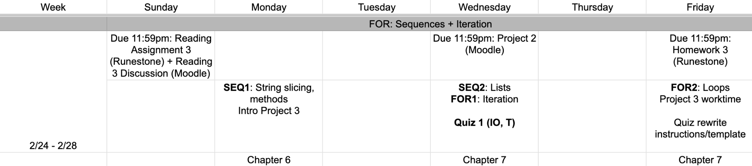
upcoming week
google sheet link

Slide 4

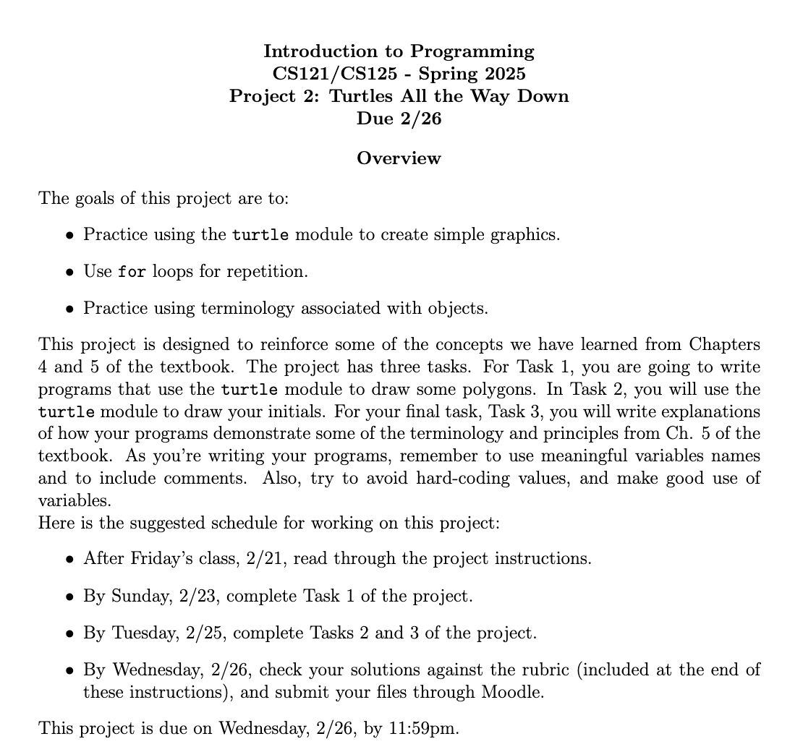
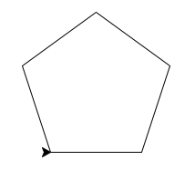
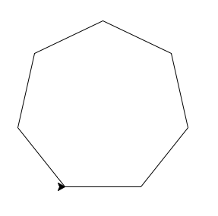
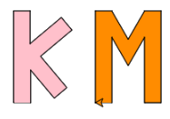
Project 2
due next Wednesday!
this slide deck will help you with task 3!!
task 1
task 1
task 2

Slide 5
Takeaways from last time
Things you should know:
we can use a for loop to repeat code
we can use documentation to learn everything available in a module
more turtle methods :)

Slide 6
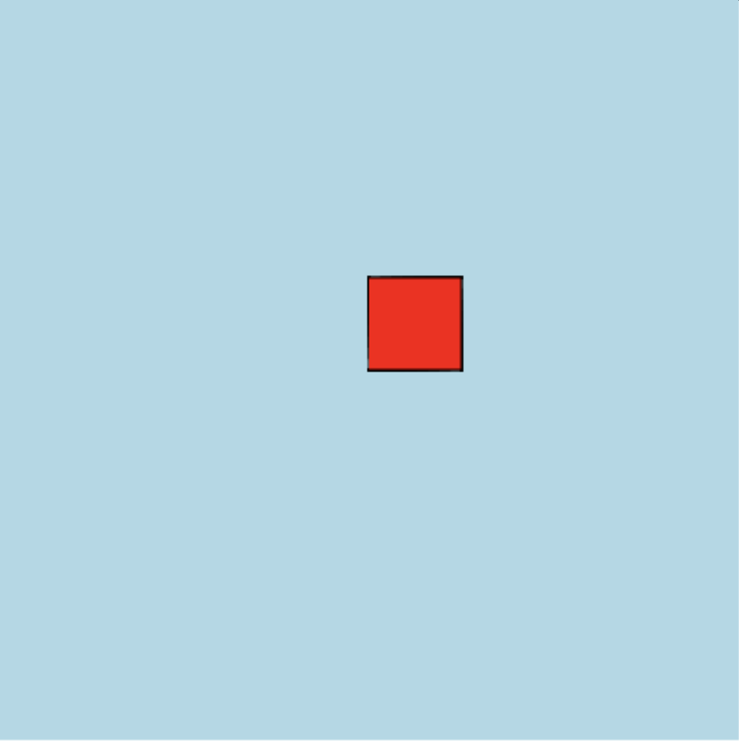
import turtle
#background
wn = turtle.Screen()
wn.bgcolor("lightblue")
#myrtle to red
myrtle = turtle.Turtle()
myrtle.fillcolor("red")
#square
myrtle.begin_fill()
for _ in range(4):
myrtle.forward(50)
myrtle.left(360/4)
myrtle.end_fill()
myrtle.hideturtle()

Slide 7
import turtle
#background
wn = turtle.Screen()
wn.bgcolor("lightblue")
#myrtle to red
myrtle = turtle.Turtle()
myrtle.fillcolor("red")
#square
myrtle.begin_fill()
for _ in range(4):
myrtle.forward(50)
myrtle.left(360/4)
myrtle.end_fill()
myrtle.hideturtle()
Classes
Screen and Turtle are examples of classes
A class is a special, user-defined
type of object
In this case, the makers of
the turtle module defined these
classes. Much later in the course, we'll
learn how to define our own
classes

Slide 8
import turtle
#background
wn = turtle.Screen()
wn.bgcolor("lightblue")
#myrtle to red
myrtle = turtle.Turtle()
myrtle.fillcolor("red")
#square
myrtle.begin_fill()
for _ in range(4):
myrtle.forward(50)
myrtle.left(360/4)
myrtle.end_fill()
myrtle.hideturtle()
instances
When we create a specific object
from a class, this is called an instance
wn is an instance of the Screen class
myrtle is an instance of the Turtle class.

Slide 9
import turtle
#background
wn = turtle.Screen()
wn.bgcolor("lightblue")
#myrtle to red
myrtle = turtle.Turtle()
myrtle.fillcolor("red")
#square
myrtle.begin_fill()
for _ in range(4):
myrtle.forward(50)
myrtle.left(360/4)
myrtle.end_fill()
myrtle.hideturtle()
methods
Each class has methods, which are functions belonging to each instance of the class
Methods are used to interact with and control the instance
bgcolor is a method of wn
fillcolor, forward, left, begin_fill, end_fill, hideturtle are methods of myrtle

Slide 10
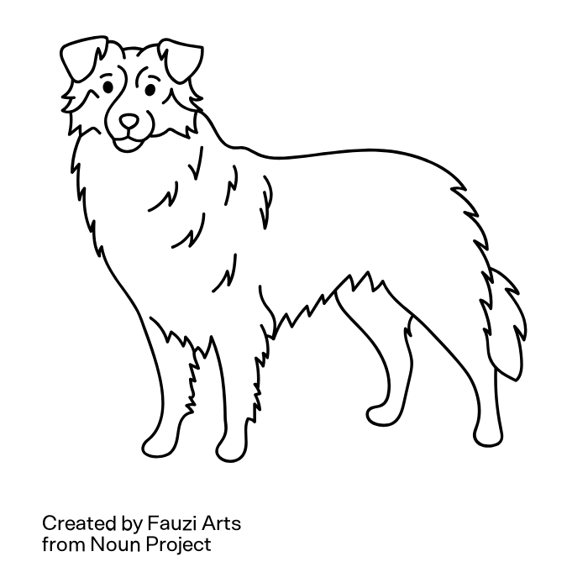
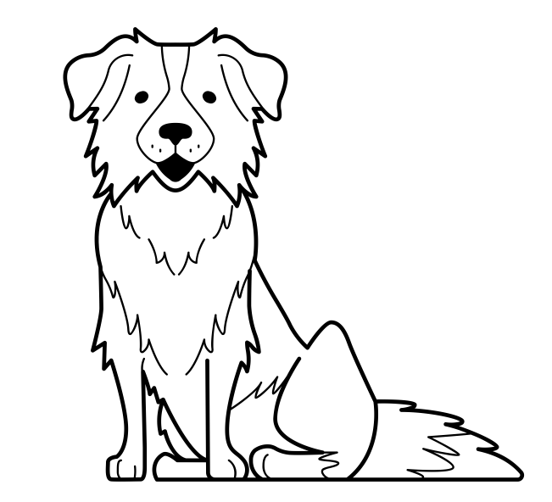
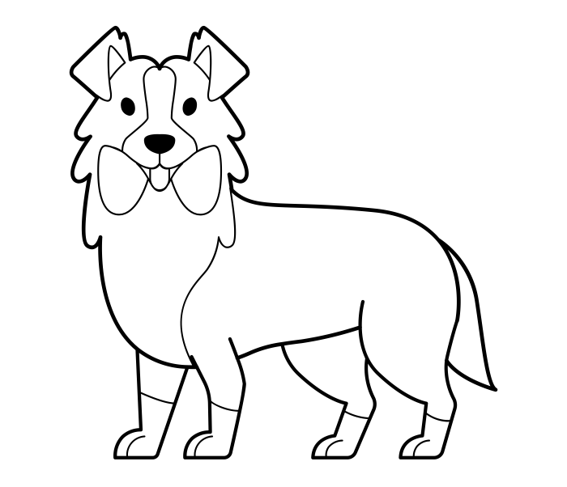
class
methods of DOG class:
sit, bark, run, chew
dog
eowyn.bark()
method of DOG class that interacts with the instance eowyn
woof
meriadoc.bark()
method of DOG class that interacts with the instance meriadoc
pippin.sit()
method of DOG class that interacts with the instance pippin
woof
eowyn
pippin
meriadoc
instance of DOG class
instance of DOG class
instance of DOG class

Slide 11
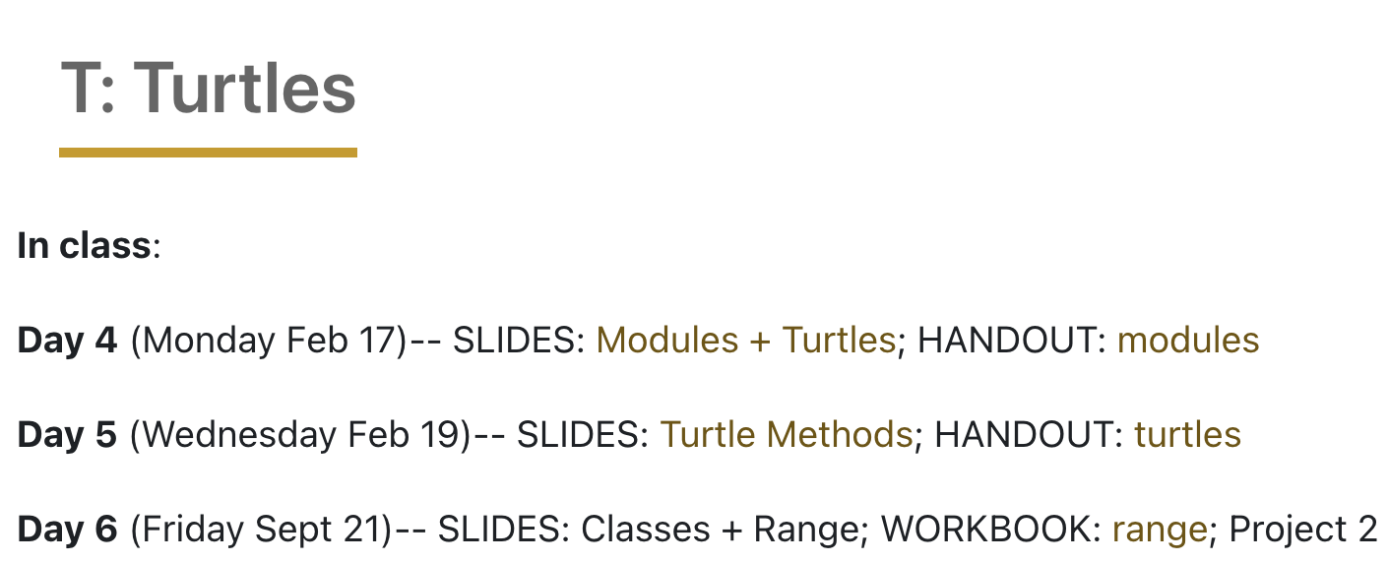
colab workbook
Link: click for access
Have at least one member of table group open this to take notes. After we are done, make sure to share with the rest of the members of your group
It is helpful to turn off autocomplete

Slide 12
We've seen how the range function can be used in a for loop to repeat code:
import turtle
myrtle = turtle.Turtle()
for _ in range(4):
myrtle.forward(50)
myrtle.left(360/4)
Let's look at the range function and these for loops more closely…

Slide 13
What is the output of the following code chunk?
for _ in range(4):
print(_)
namespace objectspace
_
x
0
output
0
x
x
1
1
2
2
3
3
Let’s take a look at some options for the range function

Slide 14
When we call the range function
with one argument:
stop
start at 0
go up by 1 each time
up until it reaches 4 (does not include 4)
for _ in range(4):
print(_)
stop
with two arguments:
start
stop
start at 3
go up by 1 each time
up until it reaches 10 (does not include 10)
for _ in range(3,10):
print(_)
start
stop
with three arguments:
stop
start
step
start at 1
go up by 3 each time
up until it reaches 11 (does not include 11)
start
for _ in range(1,11,3):
print(_)
step
stop

Slide 15
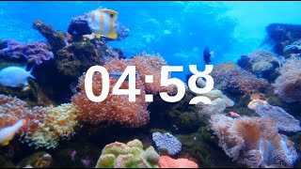
practice
workbook
sequences of numbers
Using the various options for the range function, write for loops to print the following sequences of numbers:
0, 1, 2, 3, 4, 5, 6, 7, 8, 9, 10
4, 5, 6, 7, 8
3, 7, 11, 15, 19, 23

Slide 16
we index by starting at 0 and increasing by one as we move left to right
text = “KOWABUNGA!”
0 1 2 3 4 5 6 7 8 9
kowabunga!
We can think of a string as a sequence of characters
-10 -9 -8 -7 -6 -5 -4 -3 -2 -1
We can access individual characters with indexing
we can reverse our indexing by starting at -1 and increasing by one as we move right to left
text[0] → “K”
text[-1] → “!”
text[10] →
IndexError: string index out of range
text[-5] →
text[4] → “B”
“U”

Slide 17


before next time
Finish workbook
HW2
Reading 3 + reflection
Study for Quiz 1

Slide 18
more on Strings and print statements
the following is just for fun, you do NOT need to know format or f string (unless it is of interest to you)
Below are three examples of printing out the string “red is not pink”
x = "red"
y = "pink"
print(x, "is not", y)
print(x + " is not " + y)
print("{} is not {}".format(x, y))
print(f"{x} is not {y}")
regular print statement
print statement with concatenation
print statement with format method
print statement with f string

Slide 19
import turtle
#create mabel and make her speedy
mabel = turtle.Turtle()
mabel.speed(0)
mabel.fillcolor("red")
mabel.begin_fill()
#octagon
for _ in range(8):
mabel.forward(80)
mabel.left(360/8)
mabel.end_fill()
#centering + making stick
mabel.fillcolor("black")
mabel.begin_fill()
mabel.forward(30)
mabel.right(90)
mabel.forward(200)
mabel.left(90)
mabel.forward(20)
mabel.left(90)
mabel.forward(200)
mabel.end_fill()
mabel.hideturtle()
import turtle
#create mabel and make her speedy
mabel = turtle.Turtle()
mabel.speed(0)
#octagon
mabel.fillcolor("purple")
mabel.begin_fill()
for _ in range(8):
mabel.forward(80)
mabel.left(360/8)
mabel.end_fill()
#centering + making stick
mabel.fillcolor("burlywood")
mabel.begin_fill()
mabel.forward(30)
mabel.right(90)
mabel.forward(150)
mabel.left(90)
mabel.forward(20)
mabel.left(90)
mabel.forward(150)
mabel.end_fill()
#moving for lollipop
mabel.penup()
mabel.setx(-75)
mabel.sety(85)
mabel.pendown()
#creating lollipop band
mabel.fillcolor("purple")
mabel.begin_fill()
mabel.forward(30)
mabel.right(90)
mabel.forward(240)
mabel.right(90)
mabel.forward(30)
mabel.right(90)
mabel.forward(240)
mabel.end_fill()
mabel.hideturtle()
turtle on a stick

